Slide 1
Rewind & Discard: Improving Software Resilience using Isolated Domains
Merve Gülmez & Thomas Nyman & Christoph Baumann & Jan Tobias Mühlberg
Ericsson & KU Leuven
2023/06/29

Slide 2
Memory-related run-time attacks
Software written in memory-unsafe programming languages, e.g., C and C++ can suffer from various memory-related errors
Memory errors may allow run-time attacks to compromise program behavior
Control-flow attacks
Data-oriented attacks
Attackers and malware use such run-time attacks to gain access to vulnerable systems

Slide 3
Limitations of current defenses
Code Integrity
Data Flow Integrity
AMD Shadow Stack
Arm Pointer Authentication
Code Integrity
Intel Control-flow Enforcement Technology (CET)
Stack canaries
Control Flow Integrity
W ⊕ X
CHERI
Arm Memory Tagging Extension (MTE)
Detect attacks but are not able to recover application
(Application should be terminated)
They don’t address “software resilience”

Slide 4
Problem Statement
How to improve the resilience of long-running software against run-time attacks?
Motivation:
Run-time attacks corrupt memory, alter behavior, or crash the application
Improving software resilience (“healing” from unexpected events)
One malicious request can deny service to all clients
Challenge:
Data in memory may already be corrupt when an attack is detected
Attacks may alter program behavior, conventional error handling not sufficient
Solution must be efficient, robust and be adaptable to new attacks

Slide 5
Secure Rewind and Discard with Isolated Domains
We present secure rewind and discard, an approach for recovering vulnerable applications after an attack is detected
Requirements:
Compartmentalizing the application into distinct domains A memory defect within a domain must only affect that domain’s memory Hardware-assisted software fault isolation (SFI) based on Protection Keys for Userspace in COTS processors (Intel, AMD)
Leveraging different pre-existing detection mechanisms such as stack canaries and domain violations

Slide 6
Protection Keys for Userspace (PKU)
Virtual addr. space
PTEs
User-level memory access-control mechanism
Associates each memory page with a 4-bit protection key kept in page table entry (PTE)
Access control rules for protection keys maintained by userspace code in PKRU register
phys. addr.
0x0000000000000000
phys. addr.
0x0000000000001000
phys. addr.
0x0000000000002000
phys. addr.
PKRU
phys. addr.
WD 15
AD 15
WD 14
AD 14
WD 13
AD 13
WD 0
AD 0
0x0000000000003000
write disable
access disable
0x0000000000004000
XD
Ignored
0
phys. addr. of 4kb page
Ignored
G
PAT
D
A
PCD
PWT
U/S
R/W
P
Intel. Intel® 64 and IA-32 Architectures Software Developer Manuals. Volume 1. Chapter 2.7., 4.6.2 May 2019
Notes:
16keys,
Access rules,
From Intel® 64 and IA-32 Architectures Software Developer Manuals. Vol. 3A 4-29 PAGING:
Table 4-20. Format of a Page-Table Entry that Maps a 4-KByte Page
0 (P) Present; must be 1 to map a 4-KByte page
1 (R/W) Read/write; if 0, writes may not be allowed to the 4-KByte page referenced by this entry (see Section 4.6) 2 (U/S) User/supervisor; if 0, user-mode accesses are not allowed to the 4-KByte page referenced by this entry (see Section 4.6)
3 (PWT) Page-level write-through; indirectly determines the memory type used to access the 4-KByte page referenced by this entry (see Section 4.9.2)
4 (PCD) Page-level cache disable; indirectly determines the memory type used to access the 4-KByte page referenced by this entry (see Section 4.9.2)
5 (A) Accessed; indicates whether software has accessed the 4-KByte page referenced by this entry (see Section 4.8)
6 (D) Dirty; indicates whether software has written to the 4-KByte page referenced by this entry (see Section 4.8)
7 (PAT) Indirectly determines the memory type used to access the 4-KByte page referenced by this entry (see Section 4.9.2)
8 (G) Global; if CR4.PGE = 1, determines whether the translation is global (see Section 4.10); ignored otherwise
11:9 Ignored
(M–1):12 Physical address of the 4-KByte page referenced by this entry
51:M Reserved (must be 0)
58:52 Ignored
62:59 Protection key; if CR4.PKE = 1 or CR4.PKS = 1, this may control the page’s access rights (see Section 4.6.2); otherwise, it is not used to control access rights.
63 (XD) If IA32_EFER.NXE = 1, execute-disable (if 1, instruction fetches are not allowed from the 4-KByte page controlled by this entry; see Section 4.6); otherwise, reserved (must be 0)

Slide 7
PKU Availability
PKU Deployed
in Intel Xeon CPUs since the SkyLake microarchitecture (2015)
in AMD Zen 3 CPUs
Support in Linux 4.6 (known as MPK)
User space support in GNU C Library (glibc) 2.27, GCC 5.3 (pkey_mprotect)

Slide 8
Implementation: Library for Secure Domain Rewind and Discard (SDRaD)
Allows developer to create isolated domains within application
Analogy: Software exceptions that capture memory errors within isolated domain
What can be isolated within an application?
Subroutine in main application, e.g., C function that processes unsanitized input
Libraries with possible memory vulnerabilities
Library that handles sensitive information, e.g., cryptographic keys in OpenSSL
What errors can be detected?
Stack overflows, heap overflow, domain violations
Leverage different pre-existing detection mechanisms e.g., stack canaries, CFI and more

Slide 9
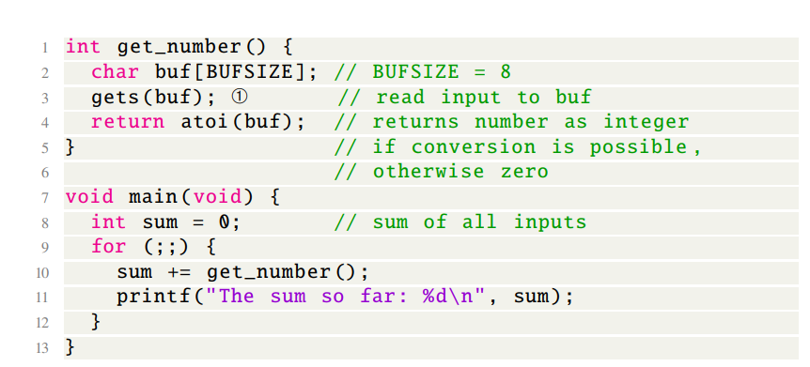
SDRaD High Level Idea
The memory vulnerability () is triggered by input that exceeds the size of the input buffer
The corruption of stack frame eventually overflow into the main function's stack frame
A vulnerable C application

Slide 10
SDRaD High Level Idea
Stack Canaries
Put guard variable into stack frame boundaries
The guards are initialized when a function is entered and then checked when the function exits.
If a guard check fails, an error message is printed, and the program exits.
A stack overflow is detected at run-time

Slide 11
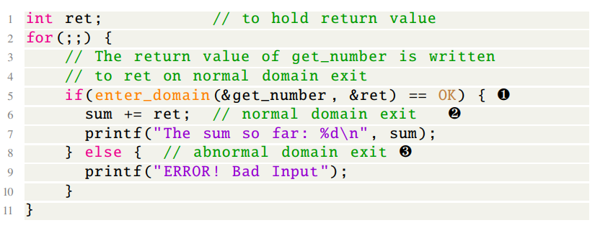
SDRaD High Level Idea
SDRaD
Domain Interaction
SDRaD Isolation
SDRaD API
Main Domain
New Domain
Intercept Call to F
Create Domain
Save Caller
Domain Transition
Invoke F
Rewind and Discard!
SDRaD Multithread Support?
Return to Caller
no
fault?
Domain Transition
yes
Domain Transition
Rewind and Discard
Domain Transition
Catch Fault
SDRaD Rewinding
Error Handling Mechanism
The program equipped with rewinding
Note that heap isolation requires domain-aware heap allocator: TLSF

Slide 12
Case Study: Memcached
Memcached is a high-performance, distributed memory object caching system
Written in C, known for its efficiency and low-level control.
Focuses on high-performance caching, no persistent storage
Event-Based Application, maximizing its responsiveness and scalability.
SDRaD can make Memcached resilient against malicious requests
and recover without affecting benign clients

Slide 13
Memcached- SDRaD
Proposal:
Each client event should be handled in a nested domain
In case of memory corruption of any event, the abnormal domain exit occurs in the nested domain
Memcached close the related connection, handling another client request without restarting

Slide 15
SDRaD Performance Evaluation
Rollback performance and latency on an abnormal domain exit
Performance impact of the isolation mechanism
Developer effort: ~550 LoC of the 29K SLoC code base (~2%)

Slide 16
SDRaD Performance Evaluation: Memcached
Rollback performance and latency on an abnormal domain exit
Memcached v. 1.4.5: CVE 2011-49717
Creates a heap overflow
It triggers the domain violations
SDRaD signal handling mechanism detects
Abnormal domain exit is occurred
Reloading10GiB of data into Memcached took about 2 minutes (not taken into account in restart time)
Abnormal Domain Exits Latency | Memcached Container Restart Time (Baseline)
3.46 µs ±0.9µs | 400000µs ± 19000µs

Slide 17
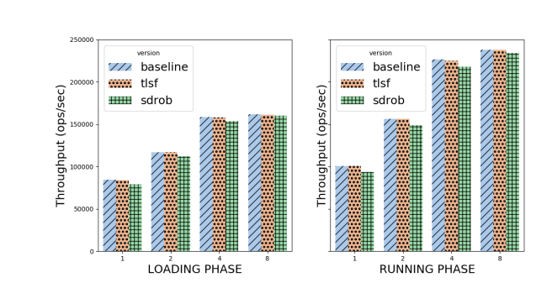
SDRaD Performance Evaluation: Memcached
Performance impact of the isolation mechanism
Yahoo Cloud Benchmark
Memcached Baseline
Memcached TLSF
Memcached SDRaD
Reasonable performance overhead
(3.0% – 7.3%)
Throughput (kbps)
Note: Highest overhead is coming from single-thread
Number of threads

Slide 18
In summary
Introducing secure rewind and discard with isolated domains,
a novel scheme to improve software resilience against run-time attacks
capable of rewinding the application state in a victim application
Providing SDRaD, a realization of secure rollback for commodity 64-bit x86 processor with PKU
Applying SDRaD to Memcached, NGINX and OpenSSL as case studies and show that SDRaD can be used with minor changes to application code and with a reasonable performance overhead (3.0% – 7.3%)

Slide 19
https://secure-rewind-and-discard.github.io/
Thank you

Slide 20
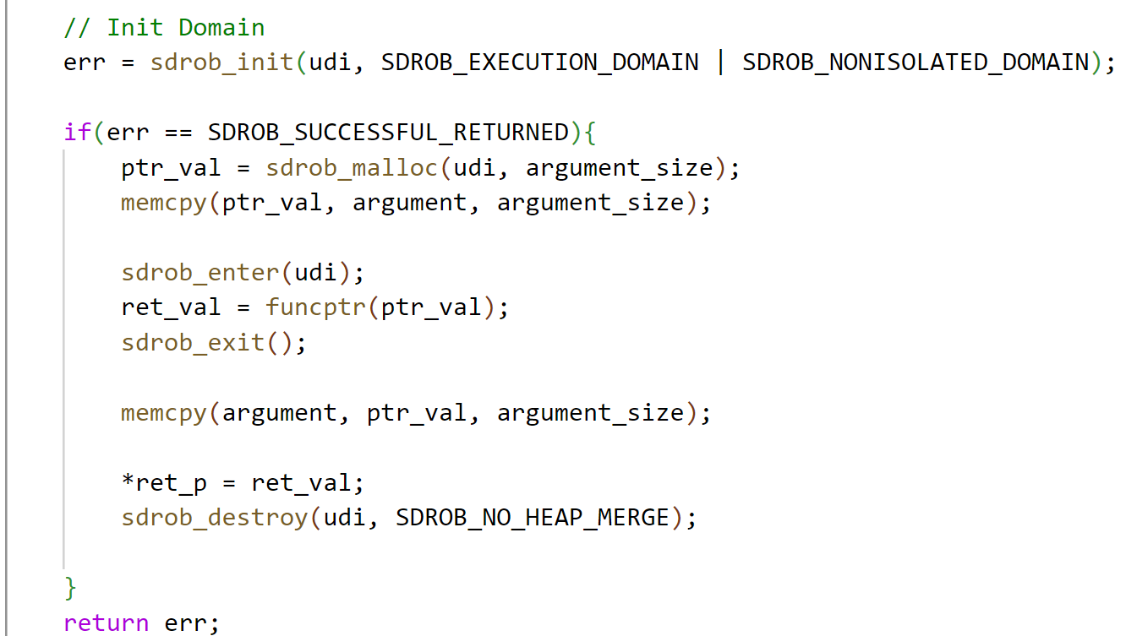
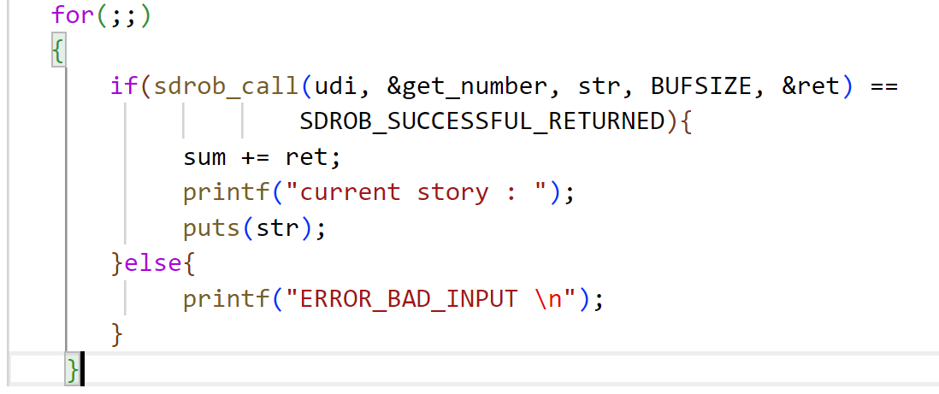
User perspective: SDRaD API
Simple wrapper function
SDRaD API
Notes:
Pthread library
To support different function pointer and argument size and we have expaned

Slide 21
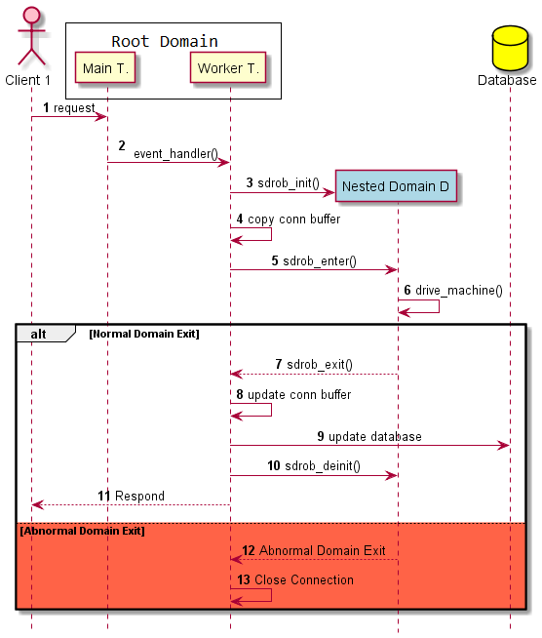
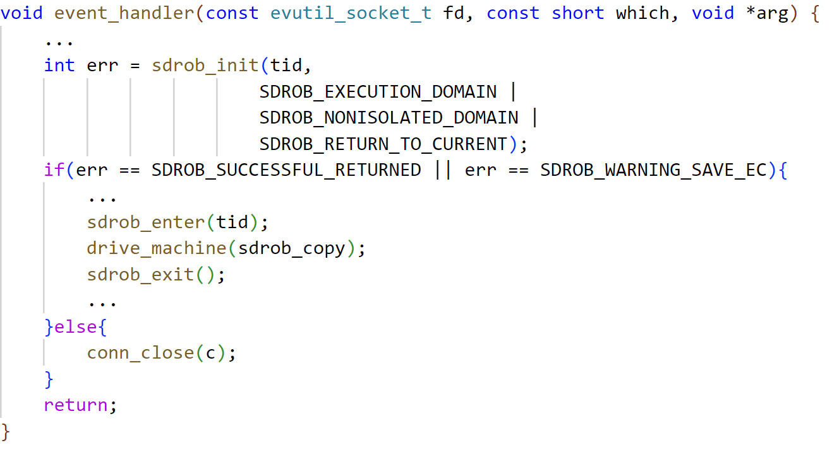
Memcached
Notes:
Delete seq number

Slide 22
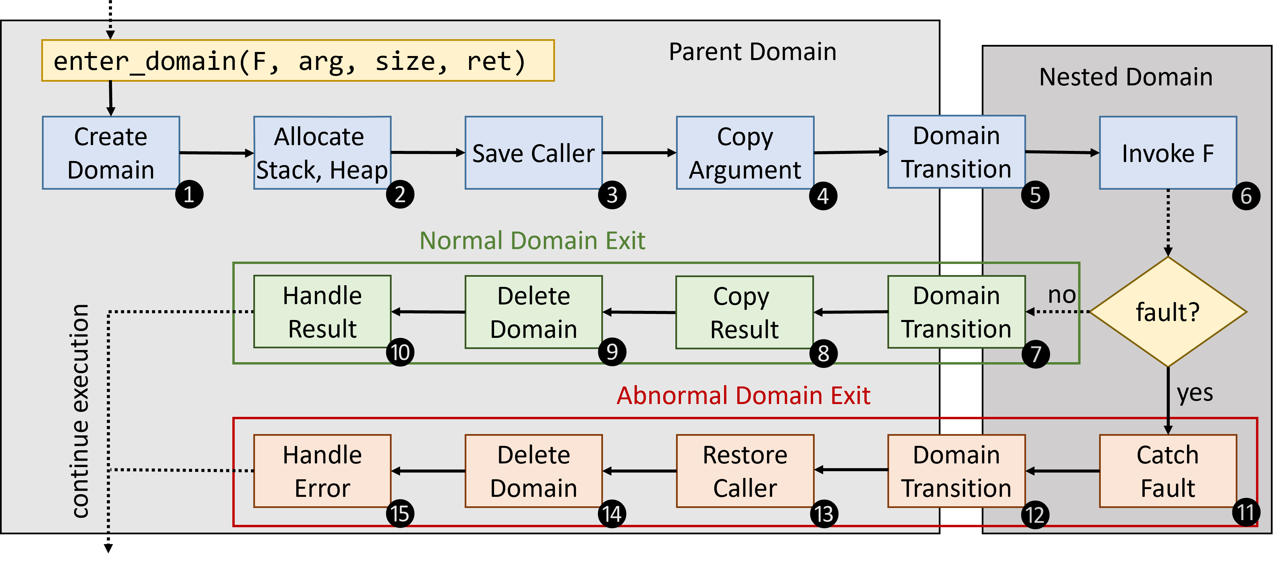
SDRaD General Overview

